Slide 1
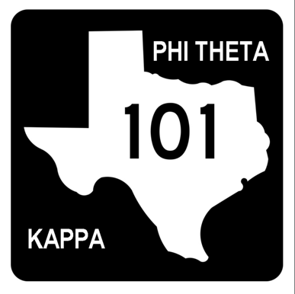
Phi Theta Kappa 101

Slide 2
SOCIETY HISTORY & STRUCTURE

Slide 3
SOCIETY HISTORY
Founded in 1918
Six charter members under the name of Kappa Phi Omicron at Stephens College in Columbia, Missouri, in 1910.
At a meeting of the president's of the Missouri junior colleges for women in 1918, it was decided to organize a new honorary society, chapters of which would have a common character, stand, and similarity of organization.
Founders modeled many aspects after Phi Beta Kappa.
Over 2 million members inducted to date.

Slide 4
SOCIETY STRUCTURE
BOARD OF DIRECTORS
EXECUTIVE DIRECTOR & INTERNATIONAL PRESIDENT
DIVISION VICE PRESIDENTS
REGIONAL COORDINATOR
REGIONAL OFFICERS
DISTRICT COORDINATOR
ADVISORS
CHAPTER OFFICERS
MEMBERS
ALUMNI

Slide 5
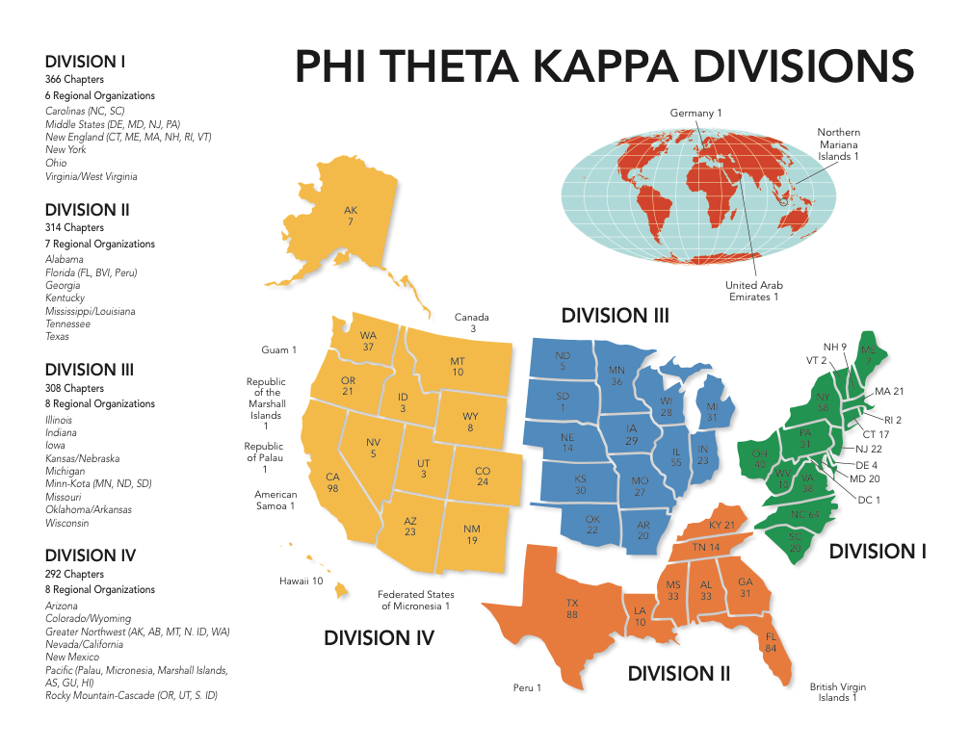
PHI THETA KAPPA DIVISIONS
International President: Amanda Karpinski, Alpha Epsilon Phi, Bergen Community College, New Jersey
Division I VP: Don Koch, Alpha Omicron Alpha, Lehigh Carbon Community College, Pennsylvania
Division II VP: Jay Fritts, Nu Upsilon, Meridian Community College, Mississippi
Division III VP: Obinna Muoh, Alpha Zeta Gamma, Highland Community College, Kansas
Division IV VP: Tasha Estein, Sigma Phi, Arapahoe Community College, Colorado

Slide 6
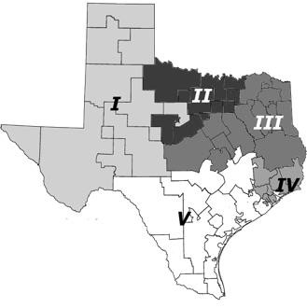
TEXAS DISTRICTS
Regional President: Michael Aguilar, Lone Star College-CyFair, Beta Lambda Mu
District I Vice President: Laura Clark, Odessa College, Eta Tau Chapter
District II Vice President: Rebecca Foster-Gillespie, Grayson College, Omicron Psi Chapter
District III Vice President: Chesney Davis, Northeast Texas Community College, Alpha Mu Chi Chapter
District IV Vice President: Stephanie McSheehy, San Jacinto College-South, Alpha Gamma Zeta Chapter
District V Vice President: Chelsea Reimer, Blinn College – Brenham, Beta Alpha Chapter

Slide 7
CHAPTER
Local branch of the Phi Theta Kappa organization.
Alpha Gamma Pi Chartered in 1977.
International Division II
Texas Region District V

Slide 8
MEMBERS

Slide 9
HALLMARKS
Scholarship
Leadership
Service
Fellowship

Slide 10
SYMBOLS

Slide 11
GREEK ALPHABET
The current Executive Director has indicated use of “PTK” is okay in certain situations.
Α | Alpha | Ι | Iota | Ρ | Rho
Β | Beta | Κ | Kappa | Σ | Sigma
Γ | Gamma | Λ | Lambda | Τ | Tau
Δ | Delta | Μ | Mu | Υ | Upsilon
Ε | Epsilon | Ν | Nu | Φ | Phi
Ζ | Zeta | Ξ | Xi | Χ | Chi
Η | Eta | Ο | Omicron | Ψ | Psi
Θ | Theta | Π | Pi | Ω | Omega

Slide 12
WEARING REGALIA

Slide 13
SOCIETY PROGRAMS

Slide 14
EVENTS
International Honors Institute (June)
Texas Honors Institute (July)
Texas Leadership Conference (October)
District Meetings (November)
Texas Region Hallmark Workshops (November)
Texas Regional Convention (February/March)
International Convention (March/April)

Slide 15
FIVE STAR COMPETITIVE EDGE
Professional Development
Critical Thinking
Professional Etiquette
Soft Skills
Five Star Pin

Slide 16
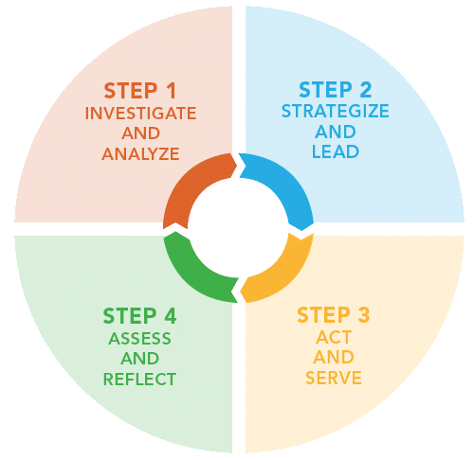
HONORS IN ACTION
Fosters Intellectual Growth
Challenges Students in Servant Leadership
Interdisciplinary, Contemporary Topics
Personal Experiences & Academic Exploration
Leadership Opportunities

Slide 17
COLLEGE PROJECT
Fosters Communication with College Administration
College and Members Work Together to Meet College Goal

Slide 18
CollegeFish.org
College matches connect you to best-fit transfer options.
Access to over $37 million in transfer scholarships.
Create your own Transfer Success Plan.

Slide 19
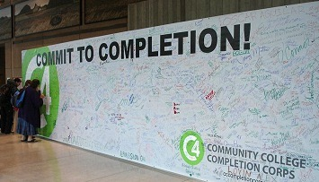
C4: COMMUNITY COLLEGE COMPLETION CORPS
Promotes Completion of Two-Year Degrees
Collaboration with the AACC (American Association of Community Colleges)

Slide 20
NOTA BENE
Phi Theta Kappa’s Anthology
Research Papers, Poetry, Short Stories, Essays, and Drama Accepted
Word Limit of 2,500
Members in Two-Year College Only
Due Sometime in December

Slide 21
SOURCES
www.ptk.org
www.txptk.org
www.ptk.org/Programs/FiveStarCompetitiveEdge.aspx
www.ptk.org/Programs/HallmarkAwards.aspx
www.collegefish.org
www.cccompletioncorps.org/
www.ptk.org/Programs/NotaBeneLiteraryCompetition.aspx

Slide 22
WORKSHOP INFORMATION
Phi Theta Kappa 101
Alpha Gamma Pi Alumni Association of Phi Theta Kappa International Honor Society of Two-Year Colleges
Created: Summer 2013
Last Revised: Fall 2017
This text was created for the members of the Alpha Gamma Pi Chapter of Phi Theta Kappa International Honor Society of the Two-Year College. The Alpha Gamma Pi Alumni Association of Phi Theta Kappa presents this workshop to continue to uphold the purpose of Phi Theta Kappa and provide continuing fellowship by supporting the people, programs, and the priorities of Phi Theta Kappa, as well as Austin Community College. The Phi Theta Kappa 101 workshop is presented as a gathering of knowledge from five former chapter presidents. These presidents have combined 30 year knowledge of Phi Theta Kappa and its programs and have served the chapter, college, community, and region. The Alpha Gamma Pi Alumni Association hopes that this workshop will inspire your sense of leadership and encourage you to take a step towards expanding your educational goals.
Katherine Lyon – Chapter President Fall 2009 and Spring 2010
Jennifer Palmer-Lee – Chapter President Fall 2010
Garrett Staas – Chapter President Spring 2012
Holly Carrico – Chapter President Fall 2012 and Spring 2013
Katherine Vasicek – Chapter President Fall 2013
© 2013 Alpha Gamma Pi Alumni Association
© 2017 Alpha Gamma Pi Alumni Association

